Slide 1

HOSPITAL WEBSITE
LANDING PAGE
Enhancing User Expierence and Engagement

Slide 2

INTRODUCTION
The landing page is the first impression users have of the hospital website.
Using landing pages is beneficial both for you and for your potential patients.
Nowadays, people are more aware of their medical needs, and most of them have learned enough about search engines to know how to look for whatever interests them.

Slide 3

IMPORTANCE OF A LANDING PAGE
The job of a medical landing page is to communicate lots of important information in regards to your health and wellness marketing.
You’ll talk about your service, pricing, and important health information.
The software has a facility to give a unique ID for every paitent and stores the details of every paitent and the staff automatically

Slide 4
ABSTRACT: Enhancing User Experience and Engagement on Hospital Website Landing page
The landing page of a hospital website plays a crucial role in creating a positive first impression and engaging users . This presentation focuses on the importance of a well-designed landing page and highlights key elements that contributes to its effectiveness.
The job of a medical landing page is to communicate lots of information in regards to your health and wellness marketing . This will talk about the hospital services and important health information . This landing page shows the complete information about the hospital and their doctors qualification and their patients reviews . It contains a booking page to book their appointment and contains blogs . This helps for advertising the hospital facilities and services so that people get an overview of the Hospital.

Slide 5
PURPOSE
Hospitals are the essential part of our lives, providing best medical facilities to people suffering from various illness , which may be due to change in climate conditions ,increased work-load, emotional stress etc . It is necessary for hospitals to keep track of its day-to-day activities and reviews of its patients ,doctors ,nurses, staff personals.
This Hospital has required a landing page, a medical landing page covers important information about health-related services.
The purpose of this project is to develop a well-designed hospital website landing page that serves as an effective gateway for visitors to access important information about the hospital's services, facilities, and commitment to patient care. The landing page will act as a key component of the hospital's online presence, providing a user-friendly interface that engages and informs potential patients.

Slide 6
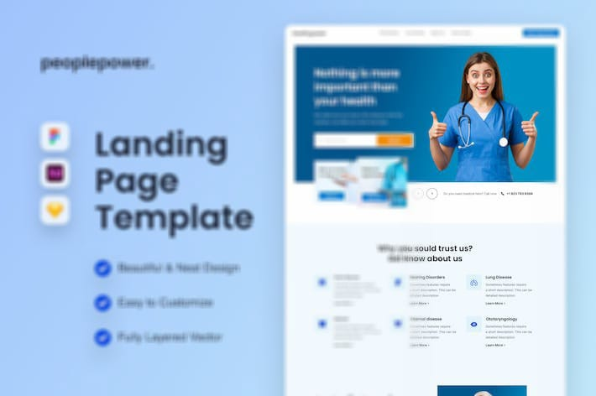
KEY ELEMENTS OF AN
EFFECTIVE LANDING PAGE
You can use medical landing pages for various purposes, like the basis of an advertising campaign.
Let’s say that you’re a dentist with a medical landing page about tooth removal. Any marketing campaigns you do, such as:
Social media advertising
Radio advertising
Billboards

Slide 7
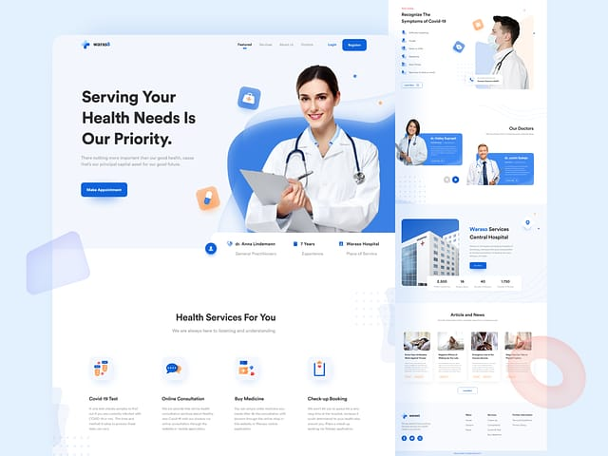
EXAMPLE OF HOSPITAL LANDING PAGE

Slide 8
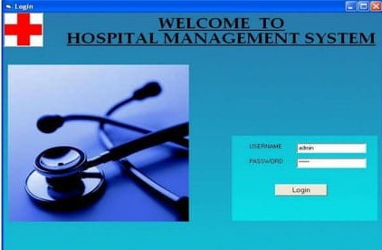
Login form:

Slide 9
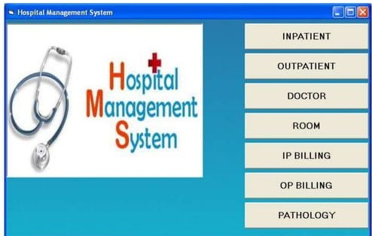
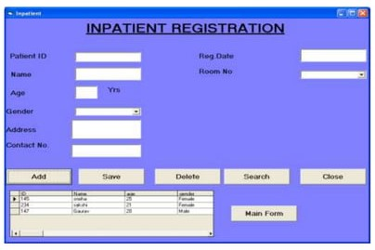
Homepage of Hospital Management System
Inpatient Registration Form

Slide 10
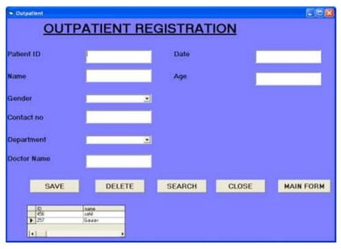
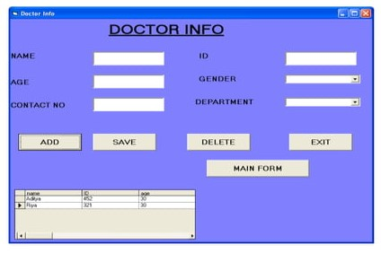
Outpatient Registartion Form
DOCTOR INFO

Slide 11
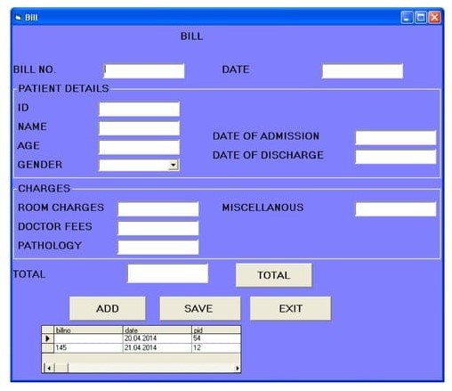
Inpaitient
Billing Form

Slide 12
SOFTWARE REQUIREMENTS USED FOR
HTML AND CSS
Javascript
PURPOSE:
The hospital website landing page includes registration of patients,storing their details into the system

Slide 13
MAIN FEATURES OF THE LANDING PAGE
Responsive header section using Flex-box
Responsive home section using CSS Flex-box
Responsive count box section using CSS Grid
Responsive services box section using CSS Grid
Responsive about section using CSS Flex-box
Responsive Team Card section using CSS Grid
Responsive contact/booking form section using CSS Flex-box
Responsive review card section using CSS Grid
Responsive news box section using CSS Grid
Responsive footer section using CSS Grid

Slide 14
CONCLUSION
This can be powerful tool to help healthcare organisations improve their processes and streamline their operations.
The primary goal of creating a medical website is to connect people to health care facilities and professionals.
By creating , increasing brand awareness of hospital by means of strategic planning and brand awareness plan execution.
This landing page will serve as an effective solution to enhance the hospital's online presence,improve communication with potential patients,streamline information accessibility,enable efficient appointment scheduling,boost patient engagement and provide a consistent user experience across various devices.

